Slide 1
Risk Management & Child Safety
August 4, 2022
Notes:
Welcome! We understand there are people here from all over the country and we know

Slide 2
Introductions
In the chat, share:
Name
Program name
State you are joining from
Back to school memory
Notes:
While we are waiting for everyone to join – please share

Slide 3

Staff Structure
WELCOME
BIANCA MYRICK
Executive Director
Pretty Purposed & Virginia Association of Environmental Education
Notes:
Bianca Myrick is the founder and executive director of Pretty Purposed, a non-profit organization dedicated to inspiring communities to empower young women and girls through mentorship and enrichment programming. As a former 5th and 6th grade educator, Bianca had a passion for working with youth and saw a need in her community where girls could use support beyond the academic curriculum. Bianca is also executive director of the Virginia Association of Environmental Education, a network that empowers educators with the tools they need to support advancing environmental literacy.
As a consultant, she is able to support individuals, organizations, and businesses, specifically in the areas of youth and organizational development. She is a 2010 graduate of Virginia State University, where she now serves as an adjunct professor, teaching other students about the nonprofit sector and philanthropy. Bianca also has a masters degree in public administration from Virginia Commonwealth University. In addition to being a grassroots nonprofit leader, she dedicates her time to grant-making and engaging in trust-based philanthropy for Black and Brown led organizations, individuals, and businesses in the DC, Maryland, and Virginia region, as a founding board member and Vice President of Collective 365. Bianca’s ultimate goal is to continue advocating for women, girls, and families through her work as a nonprofit leader, philanthropist, domestic violence advocate, and her consulting career. While she has many roles, her most exciting one is that of mom.

Slide 4
Participate in Today’s Webinar
All attendees muted for best sound
Type questions in the Q&A panel
Type comments in the Chat box
Live captions available in the panel by clicking on the “CC” at the bottom of the screen
Respond to polls
Who is with us today?
Type in the Chat to introduce yourself!
For all participants to see your message, change to “All panelists and attendees” in the Chat
Notes:
Before we get started, I want to share some housekeeping information. All attendees have been muted for the best sound, however, we want this to be a participatory experience, so please use the Q&A button in the control panel at the bottom of the screen to ask any questions to our panelists throughout the webinar. There are also live captions available by clicking on the CC Live transcript button at the bottom of your screen next to the Q&A.
Martha will be queuing up questions to share with panelists during the Q&A portion of the webinar. We may not get to all questions because there are several hundred of you on the webinar, but we will do our best! The questions that we share with our panelists are generally ones that broaden or deepen the conversation. If we are unable to get to your question today, please feel free to reach out us here at MENTOR and we’ll do our best to direct your question and get it answered.
We welcome everyone, and think and hope that today’s information will be applicable to everyone here.

Slide 5
Good to Know…
One week after the webinar, all attendees receive an email with:
Instructions for how to access a PDF of presentation slides and webinar recording
Please help us out by answering survey questions at the end of the webinar.
These materials will also be posted on the OJJDP NMRC website, at www.nationalmentoringresourcecenter.org
Notes:
Please note that today’s webinar is being recorded and in about one week, all attendees will receive an email with a copy of these slides and a link to the webinar recording. These materials will also be posted on the OJJDP NMRC website.
And to continually improve our webinars from the OJJDP NMRC, we’re looking for your input. A short survey will pop up as you exit the webinar – please take 3 minutes to give us your feedback!

Slide 6

National Mentoring Resource Center & Office of Juvenile Justice and Delinquency Prevention
This project is funded through a cooperative agreement from the Office of Juvenile Justice and Delinquency Prevention (OJJDP), Office of Justice Programs, & the U.S. Department of Justice.
The NMRC builds on OJJDP’s history, leadership, and investments in quality youth mentoring.
Notes:
The NMRC provides a free online library of resources, tools, and research reports for mentoring programs. You can visit the NMRC at nationalmentoringresourcecenter.org and find resources and recommendations on many different topics related to mentoring – you can also learn from the personal stories and experiences shared on the NMRC blog, which mentor programs contribute to regularly. OJJDP funds the NMRC and supports these webinar series each year, assisting in determining which topics are needed by programs across the country. We’d love to continue to hear from all of you on how the NMRC webinars can support you and your work etc

Slide 7
National Mentoring Resource Center Overview
Key Components:
National Mentoring Resource Center Website
Great Practitioner Focused Blog
Grantee Dedicated Part of Site
Numerous Research Vetted Resources
Evidence Reviews on Programs, Models, and Populations
Research Board
Training and Technical Assistance!
No-Cost Assistance For Your Youth Mentoring Program
Notes:
A brief overview of the NMRC.

Slide 8
Who’s in the room today?
Polls:
Are you an OJJDP Grantee, or another organization?
What is your role in mentoring? (staff/mentor/funder/etc)
Notes:
We would like to get to know a little more about you! Please take a moment to answer our poll questions--

Slide 9


Staff Structure
WELCOME
CHAD BUTT
Executive Director
MENTOR Vermont
CHAD DRISCOLL
Training & Technical Assistance Manager
America's Service Commissions
Notes:
Intro Chads / they intro selves?

Slide 10
Agenda
Introductions
What is Risky about Mentoring Programs?
Elements of Risk Management
Discussion Questions
Closing and Next Steps

Slide 11
Risky Business
Risk management as applied to mentoring programs
Practical application of the Risk Management Process
Tools for risk identification and mitigation

Slide 12

What is Risk Management?
Notes:
What’s at

Slide 13

What’s at RISK?
People
Property
Income
Goodwill

Slide 14
Risk Management Model
Identify Risks
Evaluate Risks
Think likelihood of occurrence
Magnitude of harm
Control Risks
Stop the activity
Eliminate the risks
Minimize harm
Transfer liability
Review

Slide 15

Screening Volunteers
How many volunteer screening methods can you name?

Slide 16
Screening Volunteers
Screening Volunteers
Volunteer Application
Job Description
Personal Interview
Reference Checks
Background Checks
Home Visit
Driving Record
Insurance Verification
Training

Slide 17
Advanced Volunteer Screenings
Advanced Volunteer Screenings
Isolated or unsupervised settings
Drive participants
Access to private homes
Position of authority
Access to sensitive information
Handles the organization’s money
Notes:
When you should do advanced screening

Slide 18
Organizational Risk Management
Organizational Risk Management
Think beyond “The Mentoring Relationship”
Take an inventory of risk through a risk assessment
Develop risk management policies and procedures for your ENTIRE organization
Review the program policy statements
Add policies that might be incomplete or missing
Develop new topics and policies (think COVID – eMentoring, etc.) as needed either annually or bi-annually
Review policies with your leadership, board, and insurance on a regular basis

Slide 19
Organizational Risk Management #2
Organizational Risk Management #2
Train Staff on a regular basis
Staff retreats
Regular meetings (1:1, all staff)
Include Board members, stakeholders and other partners
READ and REVIEW The Elements of Effective Practice for Mentors™ and the supplements that have been created and open sourced by MENTOR National

Slide 20
Staff Structure
Staff Structure
THINK TIME
What does your mentoring program staff look like in relation to risk management?
for example, How many staff members do you need? Of what skill levels?

Slide 21
Staff Structure
Staff Structure
Questions to ask:
Does your program have a staffing structure that is appropriate for your mentoring program scale and model?
What is the ratio of matches to staff?
How are staff roles divvied up?
Does the staffing fit the model and allow for coverage?

Slide 22
Legal Liability
Legal Liability
All Programs are vulnerable
Claims can come from:
Paid Staff
Volunteers
Participants
Funders & Donors
General Public
Notes:
Note that they should confer with their HR staff, lawyers, etc. to determine what their particular nature of legal liability is
Referenced from

Slide 23
Legal Liability
Legal Liability
First step: Understand the nature of legal liability
THINK TIME
Which parties are more likely to initiate lawsuits against your organization?
Notes:
Note that they should confer with their HR staff, lawyers, etc. to determine what their particular nature of legal liability is
Referenced from

Slide 24
What can your organization control?
What Can Your Organization Control?
Screening and selection of participants
Development of operating policies
Training of participants
Monitoring and support of participants
Procedures for handling crises
Others?

Slide 25
Liability Shields Your Organization Can Use
Liability Shields Your Organization Can Use
Contracts or agreements between a nonprofit and a participant (or parent/guardian if the participant is under 18)
A form of “transferring risk”
Common Liability Shields:
Waivers
Informed consent forms
Permission slips
Disclaimers
Closure Paperwork
Notes:
There are a few things that mentoring programs/organizations can do to “transfer risks.”
Elements of liability:
Competency
Sufficient information
Exchange of value
willful misconduct
Public Policy

Slide 26
Elements of a Risk Management Plan
Elements of a Risk Management Plan
The Plan:
Outlines the procedure(s) to be taken if a concern or accusation of inappropriate contact occurs or if something happens in the organization.
The What:
(a few examples)
Mandatory Reporters
Finance
Building and grounds
Internet control
Governance and Administration
The When:
Staff Retreats
Orientation and Training
Notes:
Download some examples to put in the chat box.

Slide 27

Think Time
What are some possible training topics or pre-match activities that can be done to support a strong start to the program during this screening period?

Slide 28
Training Resources
Training Resources
Risk Management Learning Management System (LMS) Course
Asynchronous course available to all grantees from MENTOR National
Screening 101 (based on The Elements of Effective Practice for Mentoring™
Asynchronous course available to all grantees from MENTOR National
Nonprofit Risk Management Center
Risk Assessment Page
Resources on the NMRC
https://nationalmentoringresourcecenter.org/research-tools/tools-to-strengthen-match-support-and-closure/
https://nationalmentoringresourcecenter.org/resources/program-assessment/
Notes:
Can we link website: Risk Assessment Page

Slide 29
Special Conditions for OJJDP Grantees and Related Resources
Notes:
Chad D: We know that we may have some OJJDP-funded organizations on today’s webinar, so we didn’t want to wrap up without sharing a little bit about the special condition requirements that OJJDP grantees need to follow for their awards, which may be more specific than what we have shared up until now, but are certainly very aligned with our discussion up until this point. These special conditions are specific to screening practices for mentors who will be interacting with participating minors.

Slide 30
OJJDP’s Special Conditions for Mentor Suitability
OJJDP has outlined special award conditions that grantees must follow with regard to advance determination of suitability for individuals interacting with participating minors
These special conditions, which went into effect in calendar year 2019, are outlined here: https://www.ojp.gov/funding/explore/interact-minors
Notes:
We won’t be going through the special conditions on today’s call, but did want to remind any OJJDP-funded organizations to review them at the link here. These special conditions went into affect starting in calendar year 2019.

Slide 31
Special Conditions & The Elements
Special conditions are consistent with the guidance offered in the Elements.
Special conditions are specific about the types of criterion offenses that should disqualify candidates.
MENTOR & the Elements recommend that programs use FBI background checks as one part of a comprehensive review, and that programs have qualification as well as disqualification criteria.
Notes:
OJJDP grantees may be wondering – are these special conditions aligned with what I already know from reviewing the Elements of Effective Practice?
Yes they are. You won’t find anything in the special conditions that conflicts with what we know from the EEP, but you will find specific types of criterion offenses that will disqualify candidates serving in OJJDP-funded programs.
And at MENTOR, we always want to remind folks that FBI background checks are just one part of a comprehensive review, and it’s that comprehensive review that should determine whether a volunteer is accepted for your program. A state criminal background check or FBI check is only one piece of the puzzle. Check out the Elements for a reminder about all the different checks and reviews to do to fully determine safety and suitability. We also want to remind folks that all programs should have both qualification and disqualification criteria, to help manage issues of bias and make sure that you are truly finding the right mentors for your program.

Slide 32
Screening Benchmarks for Mentors
B.2.1 Program has established criteria for accepting mentors into the program as well as criteria for disqualifying mentor applicants.
B.2.2 Prospective mentors complete a written application that includes questions designed to help assess their safety and suitability for mentoring a youth.
B.2.3 Program conducts at least one face-to-face interview with each prospective mentor that includes questions designed to help the program assess his or her suitability for mentoring a youth.
B.2.4 Program conducts a comprehensive criminal background check on prospective adult mentors, including searching a national criminal records database, along with sex offender and child abuse registries and, when relevant, driving records.
Notes:
We won’t be going over these today, but for those who like to hold onto slides for reference, this slide and the next few give you a sense of all of the different benchmarks that go into a successful screening process.

Slide 33
Screening Benchmarks for Mentors, cont’d
B.2.5 Program conducts reference check interviews with multiple adults who know an applicant (ideally, both personal and professional references) that include questions to help assess his or her suitability for mentoring a youth.
B.2.6 Prospective mentors agree in writing to a one-year (calendar or school) minimum commitment for the mentoring relationship, or a minimum time commitment that is required by the mentoring program.
B.2.7 Prospective mentors agree in writing to participate in face-to-face meetings with their mentees that average a minimum of once a week and a total of four or more hours per month over the course of the relationship, or at a minimum frequency and amount of hours that are required by their mentoring program.
Notes:
(We won’t go over these, just showing them as a reference for folks who will want to look back at them after the webinar when they receive the slides)

Slide 34
Mentor Screening Enhancements
E.2.1 Program utilizes national, fingerprint-based FBI criminal background checks.
E.2.2 Program conducts at least one home visit of each prospective mentor, especially when the match may be meeting in the mentor’s home.
E.2.3 Program conducts comprehensive criminal background checks on all adults living in the home of prospective mentors, including searches of a national criminal records database along with sex offender and child abuse registries, when the match may meet in mentors’ homes.
E.2.4 School-based programs assess mentors’ interest in maintaining contact with their mentees during the summer months (following the close of the academic school year) and offer assistance to matches in maintaining contact.
Notes:
(We won’t go over these, just showing them as a reference for folks who will want to look back at them after the webinar when they receive the slides)

Slide 35
Mentor Screening Enhancements, cont’d
E.2.5 Programs that utilize adult mentors prioritize accepting mentor applicants who are older than college-age.
E.2.6 Program uses evidence-based screening tools and practices to identify individuals who have attitudes and beliefs that support safe and effective mentoring relationship
Notes:
(We won’t go over these, just showing them as a reference for folks who will want to look back at them after the webinar when they receive the slides)

Slide 36
Mentor Screening: Step by Step
Step 1: Orientation session
Step 2: Application packet
Step 3: Formal interview and reference checks
Step 4: Criminal history and other record checks *FBI check highly recommended by Elements of Effective Practice for Mentoring (4th edition)
Step 5: Interpreting results of record checks
Step 6: Additional screening mechanisms
Step 7: Pre-match training and moving toward the match
Step 8: Match supervision
Notes:
And here’s a great overview of a successful screening process, step by step, based on the Elements. Note how criminal history and FBI checks are just one step in an 8 step process.

Slide 37

Child Protection Improvements Act (CPIA)
Notes:
You may or may not be aware of CPIA, the Child Protection Improvements Act. This act was signed into law in March 2018 on a broad bipartisan basis, and makes access to FBI fingerprint background checks available to all youth-serving organizations. Currently, roughly one third of states don’t make this access available to nonprofit youth-serving organizations, so CPIA fills this gap. Through CPIA, the FBI can only charge nonprofits the “real cost” of performing this service, which is roughly $10-12 per check (as of 2018). The Department of Justice will launch this program after completing the rule-making process for this legislation. So we hope that this new legislation will make accessing federal background checks easier for many of your programs, OJJDP-funded or not.

Slide 38
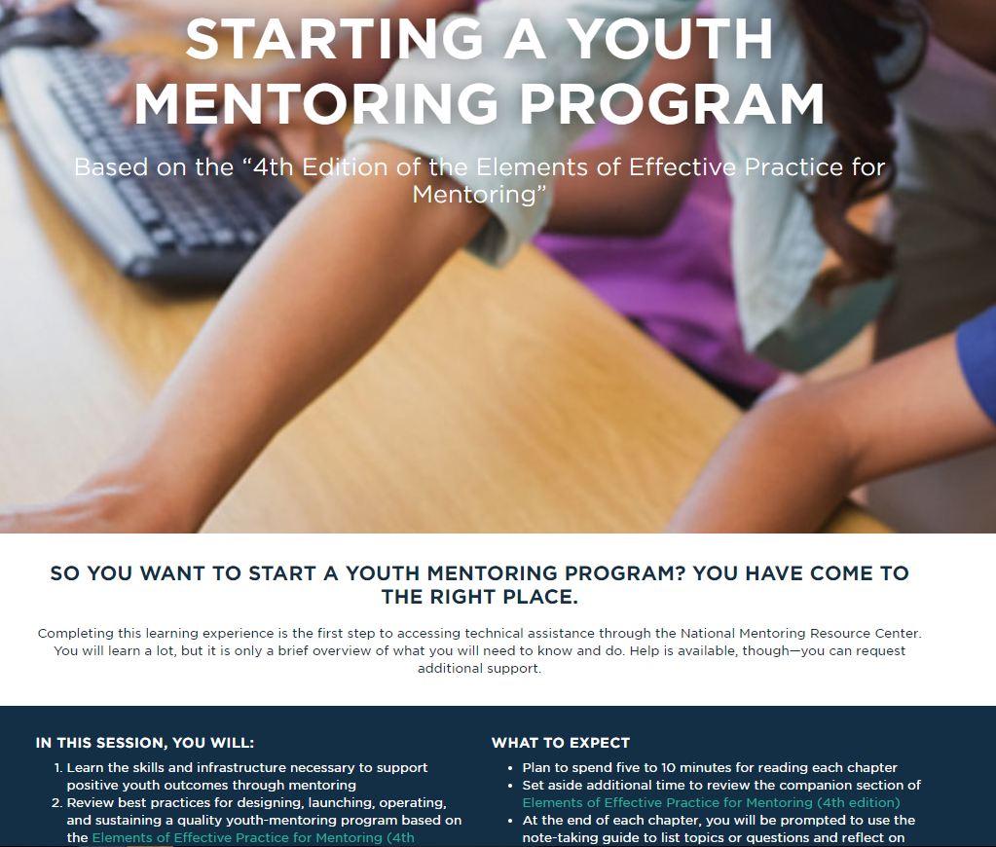
Starting a Youth Mentoring Program E-Learning Modules
Notes:
Finally, we wanted to share some additional resources from the NMRC that can help you implement a successful mentor screening process. The NMRC has created a really easy to use series of e-learning modules called “Starting a Youth Mentoring Program”, which has a great module providing an overview of mentor and mentee screening. We highly recommend it as a place to start for new programs or as a way to check the comprehensiveness of your process for established programs.

Slide 39
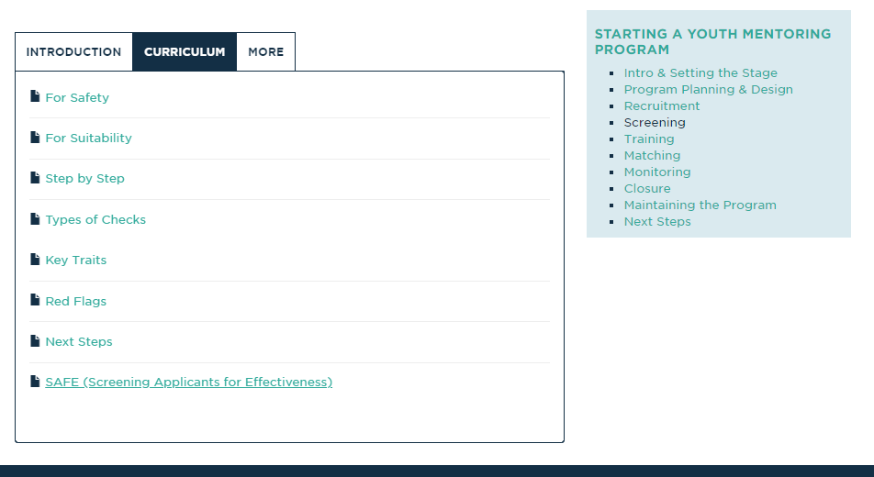
Screening Curriculum
Notes:
Here’s what it looks like, just to give you an idea of the content.

Slide 40
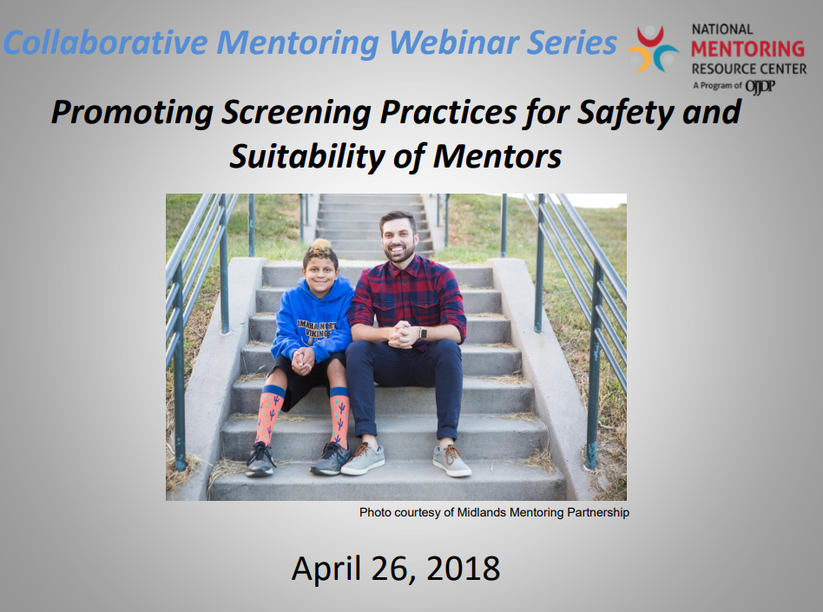
Promoting Screening Practices for Safety and Suitability Webinar
Notes:
We’ve also done other webinars through the NMRC specific to mentor screening for safety and suitability. You can find this recording on the NMRC website under “webinars”.

Slide 41
A Discussion with Chad Driscoll and Chad Butt Moderated by Bianca Myrick

Slide 42

Answering Key Questions from Our Audience

Slide 43
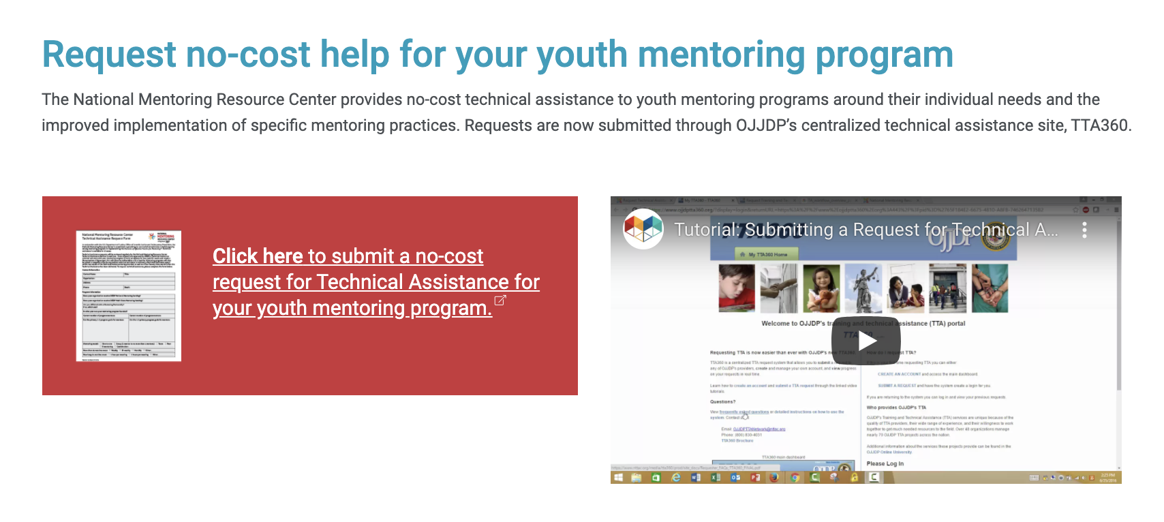
Request No-Cost Help for your Youth Mentoring Program
Notes:
A reminder for participants to apply for no-cost TA.

Slide 44
Thank you!

Slide 45

Disclaimer
Office of Juvenile Justice and Delinquency Prevention
810 7th Street NW
Washington, D.C. 20531
The opinions, findings, and conclusions or recommendations expressed in this program are those of the author(s) and do not necessarily reflect those of the Department of Justice.

